Slide 1
Fear and Loathing in the Seleukid Kingdom: Popular Resistance to Seleukid Royal Authority
Dr. Richard Wenghofer, Nipissing University
Seleukid Study Group, June 16th, 2021

Slide 2
Plutarch, Demetrius, 30
“It rather looks as though the excessive awarding of honors by the masses is no true measure of their loyalty towards kings and dynasts. Such honors are good only if they are freely given, but fear – for honors may be awarded out of fear just as much as affection – robs them of their value. Hence sensible men consider what they have actually achieved and accomplished rather than the statues and portraits and deifications they have been awarded, and even then either trust them as genuine honors or mistrust them as having been conferred by people who felt compelled to do so. After all, it is not uncommon for the people of a city, even while they are conferring honors, to hate the recipients for accepting them immodestly and arrogantly even from people who do not really want to confer them.”

Slide 3
Memnon, History of Heracleia (Jacoby, FGrH 434, 7)
“Meanwhile, Seleucus sent Aphrodisius to administer the cities of Phrygia and the upper parts of Pontus. He carried out his business, and on his return he praised the other cities, but accused the Heracleians of being hostile towards Seleucus. Irritated by this, Seleucus used threats to disparage and scare the envoys who came to him, but one of the envoys called Chamaeleon was not frightened by the threats, and said "Heracles is karron, Seleucus" ("karron" means "stronger" in the Doric dialect). Seleucus did not understand this, but remained angry, and turned away from them. The envoys could see no advantage either in returning home or in remaining where they were.” (Attalus.org. http://www.attalus.org/translate/memnon1.html)

Slide 4
The Coup of Ptolemy Keraunos (281 BCE)
“Seleucus, encouraged by his success against Lysimachus, set out to cross over to Macedonia. He longed to return to his fatherland, from which he had set out with Alexander, and he intended to spend the rest of his life there (he was already an old man), after handing over the government of Asia to his son Antiochus. 2 But Ptolemy Ceraunus, because the kingdom of Lysimachus had come under Seleucus' control, was himself accompanying Seleucus; he was not despised like a prisoner, but given the honour and consideration due to the son of a king. His hopes were raised by the promises which Seleucus made to establish him back in Egypt as the rightful heir to the kingdom, when his father Ptolemy died. 3 However, though he was honoured with so much attention, these favours failed to improve the disposition of an evil man. He formed a plot, fell upon his benefactor and killed him. Then he jumped on a horse and rushed to Lysimacheia, where he put on a diadem, and escorted by a splendid bodyguard went out to meet the army; they were forced to accept him and call him king, though they had previously served under Seleucus.” (Memnon, History of Heracleia, Jacoby, FGrH 434, 8). Attalus.org. http://www.attalus.org/translate/memnon1.html)
Year 3[1], m[onth .. . That month, the king] mustered [his troops] from the land of Sa[rdes]/[Rev.2'] and he made [his army] cro[ss] the se[a (...)] with him [and]/[Rev.3'] to the land of Macedonia, his land, [he went. General]s? with th[eir?] troops (or: from [h]is troops)/[Rev.4'] rebelledpl against him [and PN ki]lled him.” (BCPH 9, Livius.org. https://www.livius.org/sources/content/mesopotamian-chronicles-content/bchp-9-end-of-seleucus-i-chronicle/)

Slide 5
The Death of Seleukos I and Revolts in Asia Minor, the Seleukis, and Persis (281/80 BCE)
“The epimenios being Nymphios son of Diotrephes, the epistates being Dionysios son of Hippomedon, Demetrios the son of Dies spoke: Whereas King Antiochus, son of King Seleucus, when he first took over the kingship and adopted a glorious and noble policy, sought to restore the cities of the Seleukis, which were beset by difficult circumstances on account of those who were in rebellion, to peace and to their former prosperity, and, marching out against those who attacked his kingdom, as was just, (sought) to recover his ancestral empire; wherefore, embarking upon a noble and just enterprise and having not only his friends and forces eager to support him to the end in his struggle for the state but also the supernatural as a kind ally, he restored the cities to peace and his kingdom to its former condition; and now, coming to the area on this side of the Taurus (mountains) he has with all zealous concern at once established peace for the cities and brought his affairs and his kingdom to a greater and more brilliant condition, mostly thanks to his own virtue, but also thanks to the good-will of his friends and his forces….” (OGIS 219 (Ilion 32), ca. 280 BCE. http://www.columbia.edu/itc/classics/bagnall/3995/readings/b-d2-1b.htm)
“In order to rid himself of three thousand Persians, who had been involved in a revolt, Cheiles pretended to have received a threatening letter from Seleucus. He told them that, by their assistance, he hoped to bring Seleucus to reason. For this purpose, he instructed them to assemble at Randa, a town not far distant, and he promised to meet them there. In a deep and sheltered valley nearby, Cheiles posted three hundred Macedonian and Thracian cavalrymen, along with three thousand heavy-armed troops. He ordered them, as soon as they saw an iron shield raised up, to charge out and cut the Persians to pieces. The Persians assembled as they had been instructed; and Cheiles' plan was executed so effectively, that all three thousand were massacred.” (Polyaenus, Strat. 7.39. Attalus.org. http://www.attalus.org/translate/polyaenus7.html)

Slide 6
Defections at Soloi and Antioch in the Third Syrian War
“[…]…and having sailed along the coast to Soloi in [Cilicia] they seized the [money] which was deposited [there] and brought it to Seleucia. This amounted to 1,500 (talents) [of silver which] Aribazus the [general] in Cilicia intended to send it to Ephesus to Laodice, but the men of Soloi and <soldiers> on the spot had agreed among themselves, and Pythagoras and Aristocles and their men had [vigorously] come to the rescue / and…and they showed themselves gallant men, and so those funds were seized and the city and its citadel came into our hands…Aribazus escaped and sought to cross the Taurus, / but some of the local people cut off his [head] and brought it to Antioch.” (FGrH 160, Austin 220, Column II, lines 4-16. Trans. Austin, 1981)
“[After] this we came to Antioch and [there] we [found] such preparations and…that [we] were amazed. For outside the gate [there came to meet] us / the … satraps and the other officers [and soldiers], the priests, the boards of magistrates and [all the] young men [from] the gymnasium and the rest of the [crowd]… wearing [crowns], and they brought out all the sacred objects to the front of [the gate]. Some of them greeted us with their right hand, / while others … with applause and shouting.” (FGrH 160, Austin 220, Column III, lines 4-25, Trans. Austin 1981)

Slide 7
Justin, Epitome, 27.1-2on the Revolt of Antioch et al.
“ON the death of Antiochus, king of Syria, his son Seleucus, succeeding in his stead, commenced his reign with murder in his own family, his mother Laodice, who ought to have restrained him, encouraging him to it. He put to death his step-mother Berenice, the sister of Ptolemy, king of Egypt, together with his little brother, her son. By perpetrating this cruelty, he both incurred the stain of infamy, and involved himself in a war with Ptolemy. As for Berenice, when she heard that assassins were sent to despatch her, she shut herself up in Daphne; and it being reported throughout the cities of Asia, that she and her little son were besieged there, they all, commiserating her undeserved misfortunes from their recollection of the high character of her father and her ancestors, sent her assistance. Her brother Ptolemy, too, alarmed at the danger of his sister, left his kingdom, and hastened to her support with all his forces. But Berenice, before succour could arrive, was surprised by treachery, as she could not be taken by force, and killed. The deed was regarded by every one as an atrocity; and all the cities, in consequence, which had revolted (after having equipped a vast fleet), being suddenly alarmed at this instance of cruelty, and wishing to take revenge for her whom they had meant to defend, gave themselves up to Ptolemy, who, if he had not been recalled to Egypt by disturbances at home, would have made himself master of all Seleucus’s dominions. Such hatred did an unnatural crime bring upon Seleucus; or so much good feeling did the death of a sister, dishonourably killed, excite in behalf of Ptolemy! … After the departure of Ptolemy, Seleucus, having prepared a great fleet against the cities that had revolted, lost it in a storm that suddenly arose, as if the gods themselves had taken vengeance on him for his murder; nor did fortune leave him anything, of all his mighty armament, except his body and life, and a few companions amid the wreck. It was indeed a lamentable occurrence, and yet such as Seleucus might have desired; for the cities, which from hatred to him had gone over to Ptolemy, being moved, by a sudden change in their feelings, to compassionate his loss at sea (as if, in the judgment of the gods, satisfaction had been made them), put themselves again under his government.”
(Corpus Scriptorum Latinorum - http://www.forumromanum.org/literature/justin/english/trans27.html)

Slide 8
Polybius on Molon’s Revolt
“Meanwhile Molon had prepared the people (ὄχλους) of his own Satrapy to go all lengths, partly by holding out to them hopes of advantages to be gained, and partly by working on the fears of their chief men, by means of forged letters purporting to be from the king, and couched in threatening terms.” (Polyb. 5.43.5, Trans. Evelyn S. Shuckburgh, 1889)
“Having secured the camp of Xenoetas, Molon crossed the river in perfect safety and without any resistance, as Zeuxis also now fled at his approach; took possession of the latter's camp, and then advanced with his whole army to Seleucia; carried it at the first assault, Zeuxis and Diomedon the governor of the place both abandoning it and flying; and advancing from this place reduced the upper Satrapies to submission without a blow. That of Babylon fell next, and then the Satrapy which lay along the Persian Gulf. This brought him to Susa, which he also carried without a blow.” (Polyb. 5.48.12, Trans. Evelyn S. Shuckburgh, 1889)

Slide 9
Polybius on the Mutiny among Antiochos’ Troops
“The forces, however, having been mustered at Apameia, upon a kind of mutiny arising among the common soldiers, on account of some arrears of pay, Hermeias, observing the king to be in a state of anxiety, and to be alarmed at the disturbance at so critical a moment, offered to discharge all arrears…. the army generally, by a revulsion of feeling, turned with gratitude to the man to whom they owed the settlement of their claims for pay. The Cyrrhestae were the only ones that stood out: and they broke out into open mutiny, and for some time occasioned much trouble; but, being at last conquered by one of the king's generals, most of them were killed, and the rest submitted to the king's mercy.” (Polyb. 5.50.1 and 7)

Slide 10
Resistance to Antiochos III in North-Western Asia Minor
“As there was nothing small in his views he marched among the Hellespontines, the Aeolians, and the Ionians as though they belonged to him as the ruler of Asia; and indeed, they had been formerly subjects of the Asiatic kings. Then he crossed over to Europe, brought Thrace under his sway, and reduced by force those who would not obey him…. Here the open disagreements between him and the Romans began, for as he passed among the Greek cities thereabout most of them joined him and received his garrisons, because they feared capture by him. ” (App. Syr. 1 & 2 – Livius.org. https://www.livius.org/sources/content/appian/appian-the-syrian-wars/appian-the-syrian-wars-1/)
“During this year Antiochus, who had spent the winter in Ephesus, endeavoured to reduce all the cities in Asia to their old condition of dependence. With the exception of Smyrna and Lampsacus, he thought that they would all accept the yoke without difficulty, since they either lay in open level country or were weakly defended by their walls and their soldiery. Smyrna and Lampsacus asserted their right to be free and there was danger, should their claim be allowed, of other cities in Aeolis and Ionia following the example of Smyrna, and those on the Hellespont the example of Lampsacus. Accordingly he despatched a force from Ephesus to invest Smyrna and ordered the troops in Abydos to march to Lampsacus, only a small detachment being left to hold the place. But it was not only the threat of arms that he made use of, he sent envoys to make friendly overtures to the citizens, and whilst gently rebuking their rashness and obstinacy lead them to hope that in a short time they would have what they wanted. It was, however, perfectly clear to them and to all the world that they would enjoy their liberty as the free gift of the king and not because they had seized a favourable opportunity of winning it. They told the envoys in reply that Antiochus must be neither surprised nor angry if they did not patiently resign themselves to the indefinite postponement of their hopes of liberty.” (Livy, 33.38. Attalus.org)

Slide 11
Popular Revolts against Demetrius I in Antioch
“But Orophernes, with extreme ingratitude, having entered into a compact with the people of Antioch, at that time enraged against Antiochus, formed a plot to expel him from his throne by whom he was to have been restored to his own. The conspiracy being discovered, Demetrius spared indeed the life of Orophernes, that Ariarathes might not be freed from the dread of war on the part of his brother, but caused him to be apprehended, and kept a close prisoner at Seleucia. Nor were the people of Antioch so alarmed at this discovery as to desist from their rebellion. Being in consequence attacked by Demetrius, but receiving aid from Ptolemy king of Egypt, Attalus king of Asia, and Ariarathes of Cappadocia, they suborned one Bala, a young man of mean condition, to claim the throne of Syria, on pretense that it had been his father’s, by force of arms; and that nothing might be wanting to render him insolent, the name of Alexander was given him, and he was reported to be the son of King Antiochus. And such was the detestation of Demetrius among all classes, that not only royal power, but also nobility of birth, was unanimously attributed to his rival. ” (Justin, Epitome, 37.1 - http://www.forumromanum.org/literature/justin/english/trans35.html)

Slide 12
A Fickle Mob at Antioch???
“At the commencement of the war, Demetrius had entrusted two of his sons to a friend of his at Cnidus, with a large quantity of treasure, that they might be removed from the perils of the war, and might be preserved, if fortune should so order it, to avenge their father’s death. The elder of the two, Demetrius, who had passed the age of boyhood, hearing of the luxurious life of Alexander (whom his unexpected grandeur, and the fascination of enjoyments to which he was a stranger, held captive as it were in his palace, idling away his days among troops of concubines), fell upon him, with the assistance of some Cretans, when he was quite at his ease, and free from all apprehension of danger. The people of Antioch, too, to atone for their injuries to the father by new services, devoted themselves to him; and his father’s soldiers, fired with love for the young prince, and preferring the obligation of their former oath to the haughty rule of the new king, ranged themselves on the side of Demetrius; and thus Alexander, cast down with no less violent a freak of fortune than that with which he had been raised, was defeated and killed in the first battle, paying the penalty of his conduct both to Demetrius whom he had slain, and to Antiochus, from whom he had pretended to derive his birth.” (Justin, Epitome, 35.2 - http://www.forumromanum.org/literature/justin/english/trans35.html)

Slide 13
Revolts against Demetrius II
“And now when Demetrius saw that there was peace every where, and that there was no danger, nor fear of war, he disbanded the greatest part of his army, and diminished their pay; and even retained in pay no others than such foreigners as came up with him from Crete, and from the other Islands. However, this procured him ill will and hatred from the soldiers: on whom he bestowed nothing from this time: while the Kings before him used to pay them in time of peace; as they did before; that they might have their good will; and that they might be very ready to undergo the difficulties of war, if any occasion should require it.” (Josephus, AJ 13.4.9)
“Now the people of Antioch hated Demetrius, both on account of what mischief he had himself done them; and because they were his enemies also on account of his father Demetrius, who had greatly abused them. So they watched some opportunity, which they might lay hold on, to fall upon him. And when they were informed of the assistance that was coming to Demetrius from Jonathan, and considered at the same time that he would raise a numerous army, unless they prevented him, and seized upon him; they took their weapons immediately, and encompassed his palace, in the way of a siege; and seizing upon all the ways of getting out, they sought to subdue their King. And when he saw that the people of Antioch were become his bitter enemies, and that they were thus in arms, he took the mercenary soldiers which he had with them, and those Jews who were sent by Jonathan, and assaulted the Antiochians.” ((Josephus, AJ 13.5.3)

Slide 14
Demetrius II and the Massacre at Antioch
Now the people of Antioch hated Demetrius, both on account of what mischief he had himself done them; and because they were his enemies also on account of his father Demetrius, who had greatly abused them. So they watched some opportunity, which they might lay hold on, to fall upon him. And when they were informed of the assistance that was coming to Demetrius from Jonathan, and considered at the same time that he would raise a numerous army, unless they prevented him, and seized upon him; they took their weapons immediately, and encompassed his palace, in the way of a siege; and seizing upon all the ways of getting out, they sought to subdue their King. And when he saw that the people of Antioch were become his bitter enemies, and that they were thus in arms, he took the mercenary soldiers which he had with them, and those Jews who were sent by Jonathan, and assaulted the Antiochians. But he was overpowered by them: for they were many ten thousands; and was beaten. But when the Jews saw that the Antiochians were superior, they went up to the top of the palace, and shot at them from thence. And because they were so remote from them by their height, that they suffered nothing on their side, but did great execution on the others, as fighting from such an elevation; they drove them out of the adjoining houses; and immediately set them on fire. Whereupon the flame spread it self over the whole city, and burnt it all down. This happened by reason of the closeness of the houses; and because they were generally built of wood. So the Antiochians, when they were not able to help themselves, nor to stop the fire, were put to flight. And as the Jews leaped from the top of one house, to the top of another, and pursued them after that manner; it thence happened that the pursuit was so very surprizing. But when the King saw that the Antiochians were very busy in saving their children, and their wives; and so did not fight any longer; he fell upon them in the narrow passages, and fought them, and slew a great many of them: till at last they were forced to throw down their arms, and to deliver themselves up to Demetrius. So he forgave them this their insolent behaviour; and put an end to the sedition. ” (Josephus, AJ, 13.5.3)

Slide 15
Popular Hatred for Demetrius II, Antiochos VII, Diodotos Tryphon, and Cleopatra Thea
“Now a little while after Demetrius had been carried into captivity, Trypho his governour, destroyed Antiochus, the son of Alexander, who was also called the God: and this when he had reigned four years. Though he gave it out that he died under the hands of the surgeons. He then sent his friends, and those that were most intimate with him to the soldiers; and promised that he would give them a great deal of money if they would make him King. He intimated to them that Demetrius was made a captive by the Parthians: and that Demetrius’s brother Antiochus, if he came to be King, would do them a great deal of mischief, in way of revenge for their revolting from his brother. So the soldiers, in expectation of the wealth they should get by bestowing the Kingdom on Trypho, made him their ruler. However, when Trypho had gained the management of affairs, he demonstrated his disposition to be wicked. For while he was a private person he cultivated a familiarity with the multitude, and pretended to great moderation; and so drew them on artfully to whatsoever he pleased. But when he had once taken the Kingdom, he laid aside any farther dissimulation, and was true Trypho: which behaviour made his enemies superior to him. For the soldiery hated him, and revolted from him to Cleopatra, the wife of Demetrius; who was then shut up in Seleucia, with her children. But as Antiochus, the brother of Demetrius, who was called Soter, was not admitted by any of the cities on account of Trypho; Cleopatra sent to him, and invited him to marry her, and to take the kingdom. The reasons why she made this invitation were these: That her friends persuaded her to it: and that she was afraid for herself, in case some of the people of Seleucia should deliver up the city to Trypho.” (Josephus, AJ. 13.7.1)

Slide 16
The People of Babylonia Defect to Antiochos VII and then Immediately Revolt
“Many kings of the east met Antiochus on his march, offering him themselves and their kingdoms, and expressing the greatest detestation of Parthian pride. Nor was there any delay in coming to an engagement. Antiochus, being victorious in three battles, and having got possession of Babylon, began to be thought a great man. All the neighbouring people, in consequence, joining him, nothing was left to the Parthians but their own country. It was then that Phraates sent Demetrius into Syria, with a body of Parthians, to seize the throne, so that Antiochus might be recalled from Parthia to secure his own dominions. In the meantime, since he could not overthrow Antiochus by open force, he made attempts upon him everywhere by stratagem. On account of the number of his forces, Antiochus had distributed his army, in winter quarters, through several cities; and this dispersion was the cause of his ruin; for the cities, finding themselves harassed by having to furnish supplies, and by the depredations of the soldiers, revolted to the Parthians, and, on an appointed day, conspired to fall upon the army divided among them, so that the several divisions might not be able to assist each other.” (Justin, Epitome, 38.10)

Slide 17
A Second Wave of Popular Revolts Against Demetrius II in Syria
“AFTER Antiochus and his army were cut off in Persia, his brother Demetrius, being delivered from confinement among the Parthians, and restored to his throne, resolved, while all Syria was mourning for the loss of the army, to make war upon Egypt …. Cleopatra his mother-in-law promising him the kingdom of Egypt, as a recompense for the assistance that he should afford her against her brother. But, as is often the case, while he was grasping at what belonged to others, he lost his own by a rebellion in Syria; for the people of Antioch, in the first place, under the leadership of Trypho, and from detestation of the pride of their king (which, from his intercourse with the unfeeling Parthians, had become intolerable), and afterwards the Apamenians and other people, following their example, revolted from Demetrius in his absence. Ptolemy, king of Egypt, too, who was threatened with a war by him, having learned that his sister Cleopatra had put much of the wealth of Egypt on ship-board, and fled into Syria to her daughter and son-in-law Demetrius, sent an Egyptian youth, the son of a merchant named Protarchus, to claim the throne of Syria by force of arms, having forged a story, that he had been admitted into the family of King Antiochus by adoption, and the Syrians, at the same time, refusing no man for their king, if they might but be freed from the insolence of Demetrius. The name of Alexander was given to the youth, and great succours were sent him from Egypt. (Justin, Epitome 39.1)

Slide 18
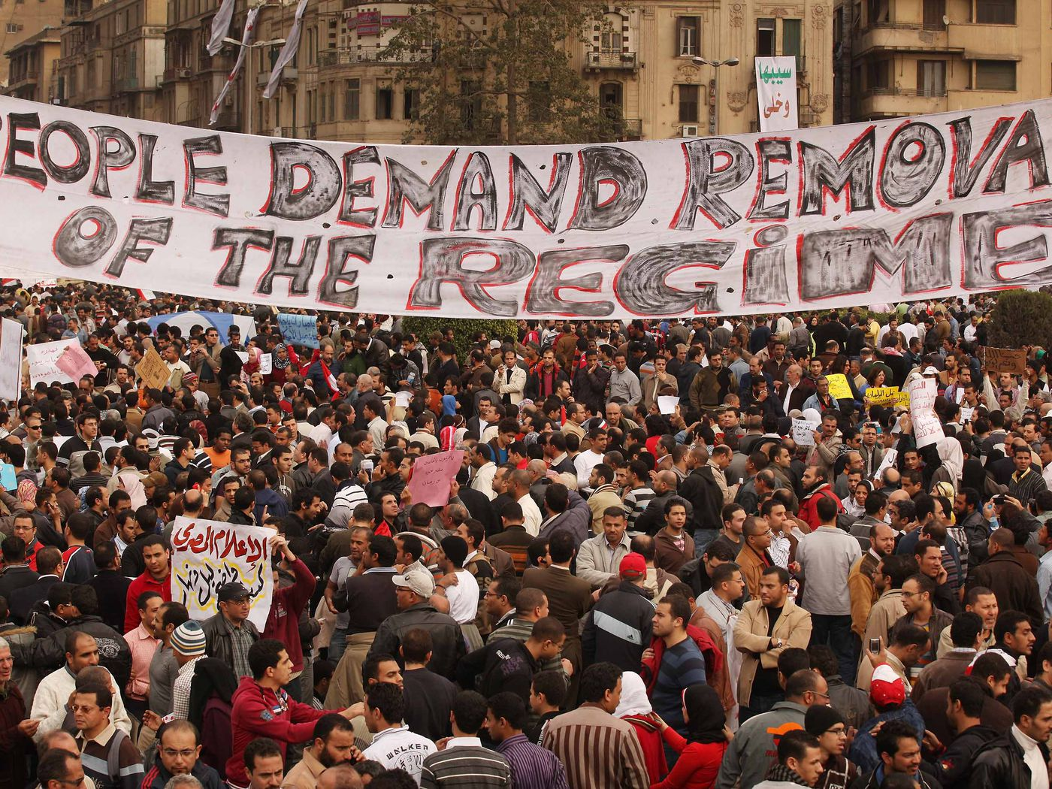
Fear, Loathing, and Popular Resistance

