Slide 1

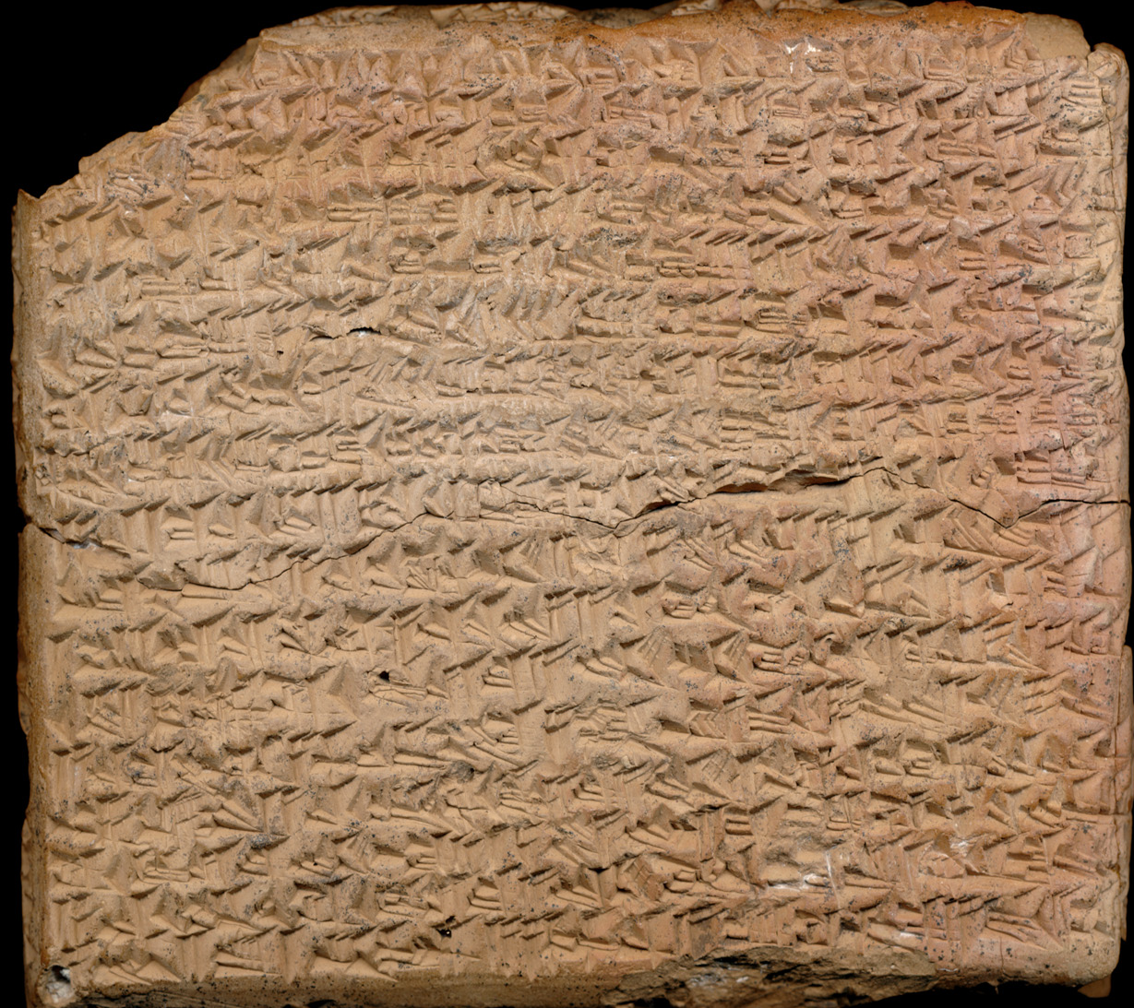

Uncommon Hellenistic Names along the Passageways of Gods, Kings, and Peoples
Nicolaas Emile P. Verhelst, MA

Slide 2
[L’étude] des noms de personne, le mieux qu’on puisse [en] dire est que nous devinons en elle un instrument de sondage dont les résultats seront merveilleux, – lorsque nous en posséderons vraiment la technique. Nous en sommes, aujourd’hui, encore loin.
Marc Bloch 1932
Nous devons faire non point des catalogues de noms, mais l’histoire des noms, et même l’histoire par les noms.
Louis Robert 1934

Slide 3
Contents
Introduction
  The source material and its context
  Status quaestionis
Uncommon names (la technique)
  An unhabitual corpus
  Defining uncommon names
Three hypotheses (l’histoire des noms)
  Geographic origin and distribution
  Social context
  Intrinsic meaning and structure
Synthesis (l’histoire par les noms)
Local elites in Hellenistic Babylonia actively expressed their multi-layered identity through the use of uncommon Hellenistic names.

Slide 4
The source material and its context
Source material
  Legal texts
  Astronomical diaries
  Royal chronicles
Historical context
  The End of Archives
  The Macedonian conquest
  Poliadisation
  The Parthian conquest
Textual context
  Officials, witnesses, neighbours, contracting parties
  With and without Babylonian name elements
Notes:
)

Slide 5
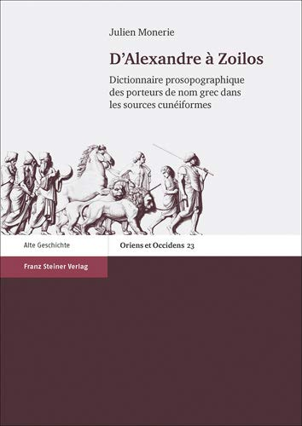
Status quaestionis
William Loftus
Tom Boiy
Julien Monerie
Laurie Pearce and Paola Corò
Kathryn Stevens

Slide 6
An unhabitual corpus
Pascal Chareille 2008
Yolanda Guillermina López Franco 2016:
  Uncommon: names that appear infrequently in a sufficiently large and representative corpus.
  Unusual: names that are infrequently used in terms of spatio-temporal standards and the discursive traditions of a specific linguistic community.

Slide 7
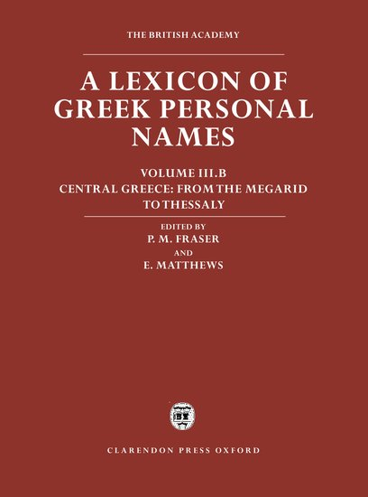


Defining uncommon names
Uncommon names
Unusual names
Less than 42 attestations (<0, 03%)
Names and name variants
67 of 196 individuals (33, 67%)
54 of 111 names (49, 55%)

Slide 8

Athènophilos, Drakontidès, Dèmias, Hèrotheos, Kantharos, Kebros, Keraunos, Kratô, Lamenès, Latikiros, Mimôn, Mnèsinos, Pausilypos, Phainis, Phanaia, Polymnis, Polytidas, Tatedidos, Theomelès, Antiochis, Charmôn, Eurydamos, Hagnotheos, Isitheos, Stasinikos, Antôn, Alexippos, Hèsiodos, Theoboulos, Athènadès, Zènophilos, Thrasymakhos, Myrtilos, Aristeus, Eudoxos, Thèrôn, Himeros, Sôsandros, Dromôn, Nikarchos, Trôilos, Diophanès, Philos, Hekataios, Hipponikos, Attinas, Aristokratès, Mènophilos, Menès, Nikèratos, Antigenès, Dèmokratès, Sôsipatros, Timarchos

Slide 9
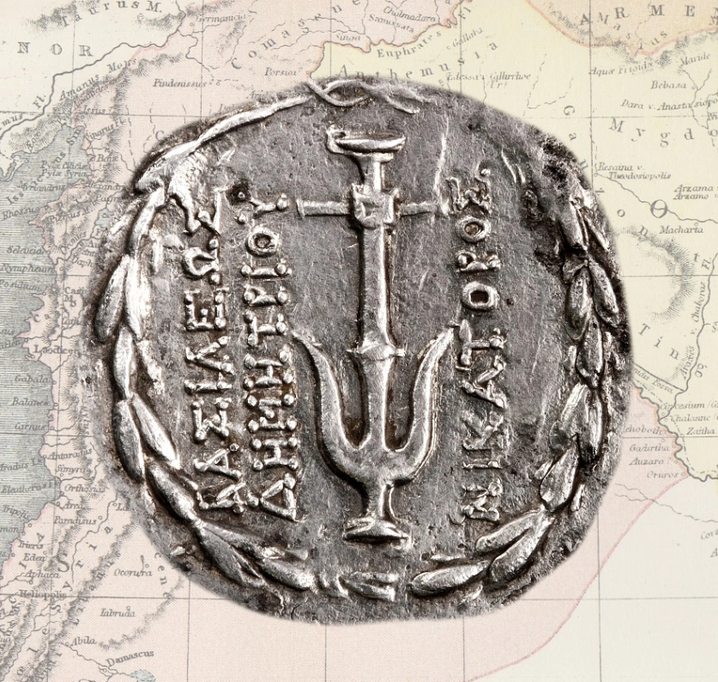
The Three-pronged Approach
Geographic origin and distribution:
  specific cultural and social ties between name-bearers and the rest of the Hellenistic world
Social distribution:
  desire of a specific part of this community to express the uniqueness of its identity through uncommon names
Instrinsic name meaning
  indicative of the value attributed to certain name categories and meanings

Slide 10
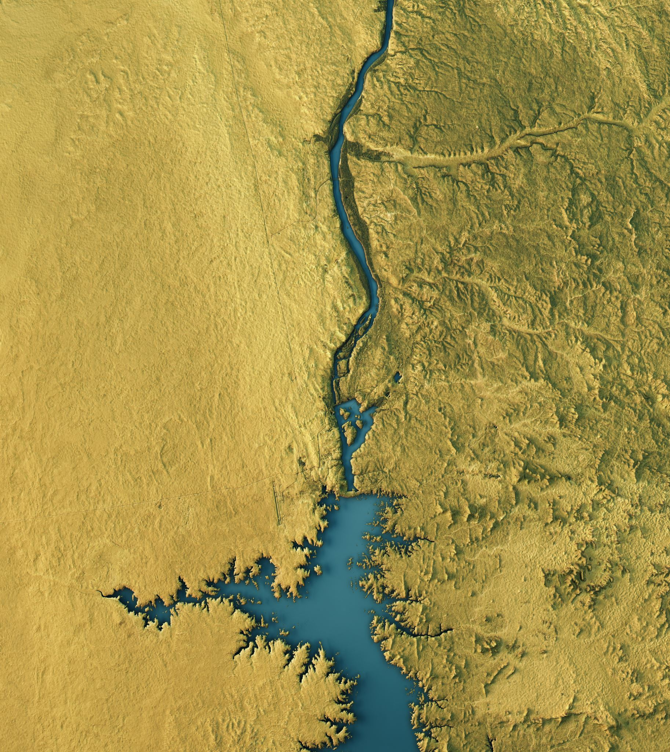
Geographic origin and distribution
Hellenic World (Greece, Asia Minor, Magna Graecia, Cyrenaica)
Hellenistic Egypt (Egypt, Sinaï, Sudan)
Dialectal variant (AV / LV)
  LGPN-Ling
Roman conquest (AT / LT)
Substrates & patterns

Slide 11
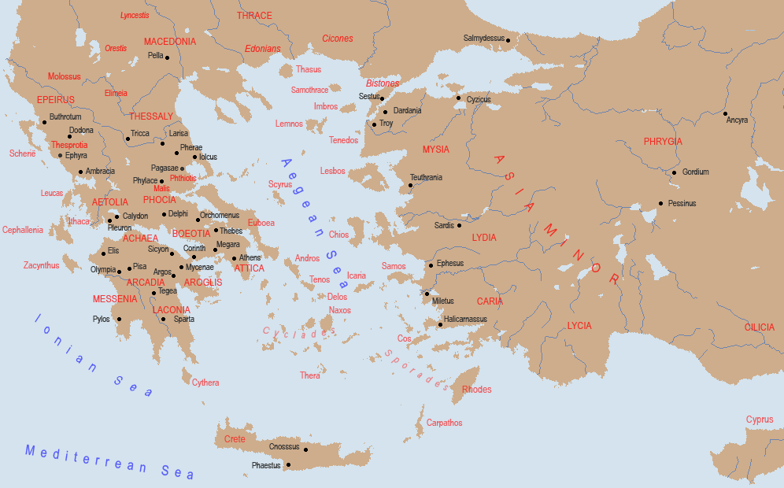

Slide 12
Geographic origin and distribution
Euboea: all very uncommon names, likely no migration
Phokis: very early and spread out migration
Dodekanesos: early migration, Babylon and Uruk
Mysia: no migration
More than just migration (26/54 names; 36/67 name bearers)

Slide 13
Social context
Social Network Analysis
Upper urban elites
  Traditional
  Family names (not Babylon)
Lower urban elites
  No family names
  More variety
Lower classes
High ranking state officials
Unclear

Slide 14
Social context
                UN% CC%
Upper urban elites 12, 31 11, 90
Lower urban elites 69, 23 80, 95
  Babylonian name elements 26, 67 48, 39
  Only Greek 42, 22 41, 93
  Minor officials 31, 11 9, 68
Lower classes 1, 54 2, 38
High ranking officials 13, 85 9, 52
Unclear 3, 08 2, 38

Slide 15
Social context
              Lower urban elite
                More low-ranking officials (Larsa)
                More without Babylonian name elements
                Generally lower (official) rank
                More women
              Generational mix
                22 CN / UN
                9 UN / CN
                4 UN / UN
              Upper elite dominated by Dodekanesian names (Nikarchos and Dèmokratès)
              Steady decline in ratio of uncommon to common names

Slide 16
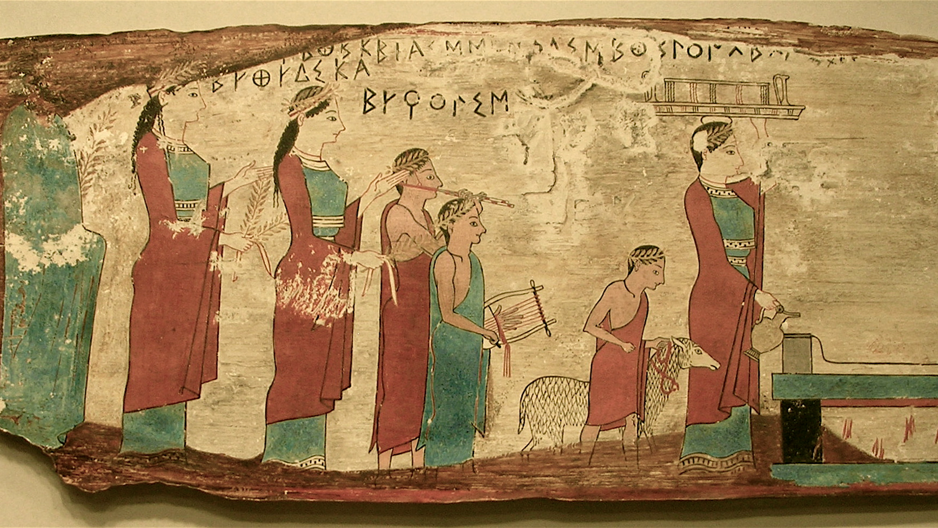
Intrinsic meaning and structure
Few clear connections between Akkadian-Greek double names (Boiy 1995; 2005)
  Artemidôros – Min-Nanāya, Dèmètrios – Nanāya-iddin, Hèliodôros – Marduk-erība
  No difference in theophoric names between cities
No hybrid names
  Tatedidos, Latekiros
Standard Greek onomastic practices
  Papponymy and maternal-line papponymy
  Repetition of name elements over generations: e.g., Isidôros / Isitheos
LGPN-Ling

Slide 17
Intrinsic Meaning
                UN% CC%
Theophoric 26, 56 38, 84
Atheophoric 73, 44 61, 98
Composite 64, 06 60, 33
Simple 35, 94 39, 67
  Including hypocoristics
Many different theophoric names:
  Zeus, Apollo, Hèraklès, Dionysos, etc.
  Mèn, Isis, Hekate
Victory, war, hunting, civic organisation, friendship, memory, plants, animals
No clear local influence

Slide 18
Synthesis: Macedonian layer
Most frequent names: Nikanôr, Kephalôn, Antiochos, Diophantos
Names with a strong Macedonian connection: Antipatros, Nikanôr, Nikolaos, Alexandros, Menandros, Philippos, Zôilos (Hatzopoulos)
Names popular in Macedonia: Antiochos, Seleukos, Kephalôn, Apollônios, Artemidôros, Dèmètrios, Hèrakleidès
61 name bearers with “Macedonian” names => 31, 12%

Slide 19
Synthesis: common Greek layer
71 name bearers with common Greek names => 35, 21%
Hints of a Phokaean substrate => migration
Hints of a Boeotian substrate
Possible Attic substrate
Far more theophoric
Uncommon names closer to Macedonian names in structure

Slide 20
Synthesis: the evolution of Greek names
Early settlements of Greek migrants
  end IV-mi. III BCE
  Phokean (end IV-st. II BCE)
  Mainly low-level officials
Influx of new names
  Mi. III-mi. II BCE
  Dodekanesian (mi. III-st. I BCE)
  Lower and higher urban elites (more in Uruk)
Poliadisation
  Mi. II-st. I BCE
  More common names
  Continuity under Arsacids

Slide 21
Synthesis: the choice of an uncommon name
Deliberate
  Very large presence
  Not localised
Informed
  Extremely uncommon names
  Greek onomastic practices
  Influenced by migrations / substrates
Social bearing
  Lower urban elites
  Minor officials
Cultural bearing
  Non-Macedonian
  Politically irrelevant parts of the Hellenistic world
Political bearing
  Separation from traditional Babylonian and Macedonian elites
  Connection to imperial, Macedonian and local, Greek (?) elites
Embracement of Greekness

Slide 22
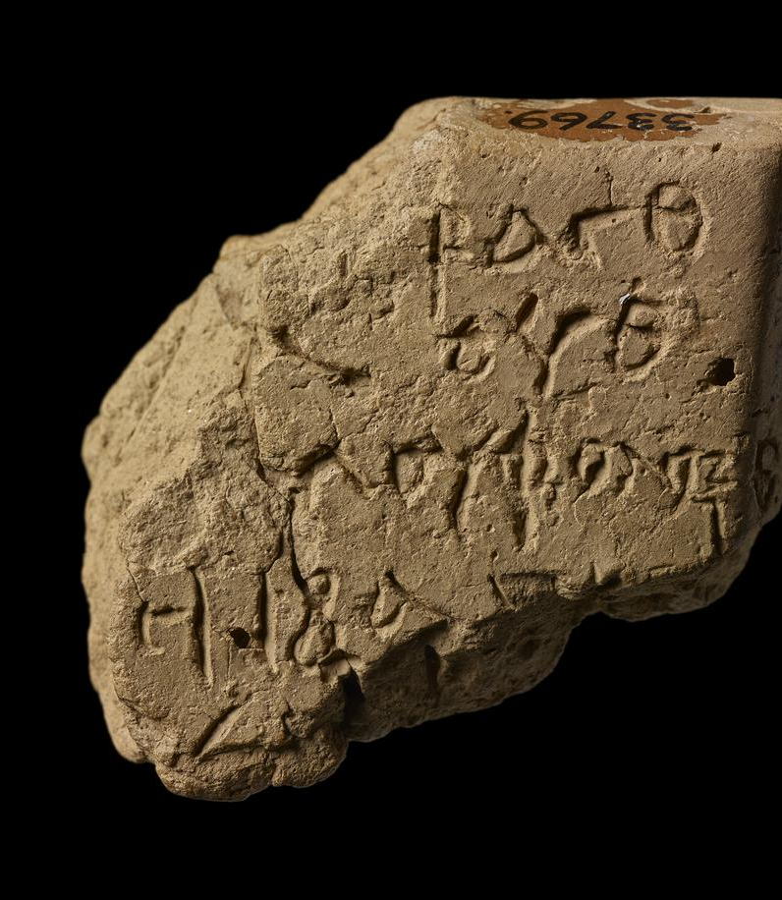
Synthesis: the consequences
Top-down?
  From the middle
A superficial Greek identity?
  Active engagement with Greek onomastics
Names =/= identity?
  Yes, but no

Slide 23
Conclusion
Local elites in Hellenistic Babylonia actively expressed their multi-layered identity through the use of uncommon Hellenistic names.

